Slide 1
Object-Oriented Program (CS F213) Lab 6

Slide 2
Agenda
Interfaces
Packages

Slide 3
Interfaces
Like a class, an interface can have methods and variables, but the methods declared in an interface are by default abstract (only method signature, no body definition).
It is defined by using keyword ‘interface’.
An interface may also contain constants, default methods, and static methods. Method bodies exist only for default methods and static methods
With interface, we can specify what a class must do, but not how it does it.
Once an interface is defined, any number of classes can implement an interface. Also, one class can implement any number of interfaces.
An interface won’t have constructors and can’t be instantiated.
If a class implements an interface and does not provide method bodies for all functions specified in the interface, then the class must be declared abstract.
With interfaces, Java allows us to fully utilize the “one interface, multiple methods” aspect of polymorphism.

Slide 4
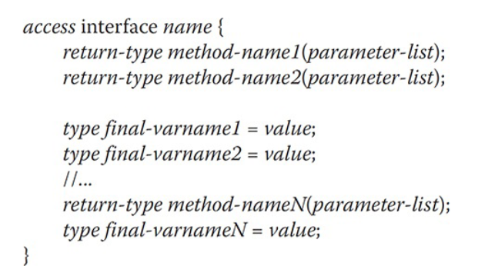
Syntax of interface
Notes:
access can be any one of both (public, and default).
Methods in interfaces are declared without any body. These methods must be implemented by the classes that implement this interface.
variables can be declared inside interface declarations, but they are implicitly final and static, meaning they cannot be changed by the implementing class. They must also be initialized
All methods and variables are implicitly public.

Slide 5
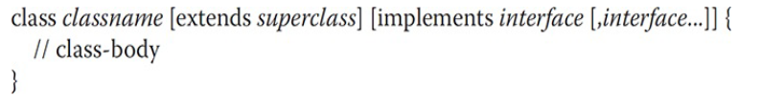
Class Implementing Interface
Once an interface has been defined, one or more classes can implement that interface. To implement an interface, include the implements clause in a class definition, and then create the methods required by the interface.
The general form of a class that includes the implements clause looks like this:

Slide 6
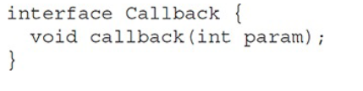
Interface Example

Slide 7
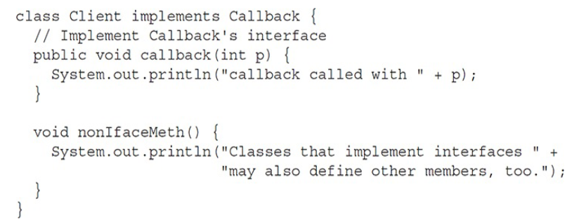
Example of a class implementing interface
Note: the callback( ) is declared using the public access modifier.

Slide 8
Interfaces Can Be Extended
One interface can inherit another by use of the keyword extends.
When a class implements an interface that inherits another interface, it must provide implementations for all methods required by the interface inheritance chain.

Slide 9
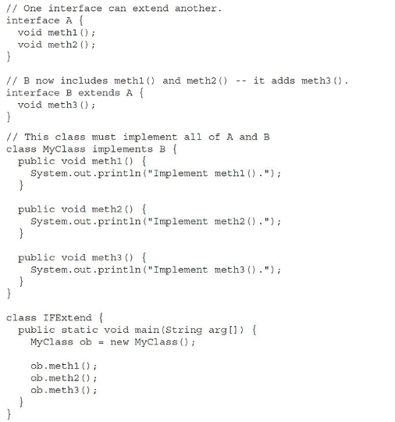
This is an example program of inheriting interfaces

Slide 10
Class Implementing Multiple Interfaces
interface A{
float VAL=6.3f;
void disp(); }
interface B{
float VAL=9.6f;
float average(); }
class C1 implements A,B{
float avg;
public float average(){
avg=(A.VAL + B.VAL)/2;
return avg;
}
public void disp(){
avg=average();
System.out.println("Average:"+ avg);
}
public static void main( String args[]){
C1 ob = new C1();
ob.disp();
}
}
Note: Multiple inheritance ca be achieved by implementing multiple interfaces.

Slide 11
Usage of ‘extends’ and implements
class
interface
interface
extends
implements
extends
class
class
interface
Note: Reference variable of an interface can be assigned object of any class thereby reuntime polymorphism can be achieved.

Slide 12
Packages
Packages act as containers for classes, interfaces and other subordinate packages. They are used to keep the class name space compartmentalized.
Why Packages?
Preventing naming conflicts. For example there can be two classes with name Employee in two packages, college.staff.cse.Employee and college.staff.ee.Employee
Providing controlled access: protected and default have package level access control.
-A protected member is accessible by classes in the same package and its subclasses.
-A default member (without any access specifier) is accessible by classes in the same package only.

Slide 13
Two types of packages
System defined packages, e.g., java.lang, java.util,etc.
User defined packages

Slide 14
Defining a user-defined pakage
Include a package command as the first statement in a Java source file.
Any classes declared within that file will belong to the specified package.
The package statement defines a name space in which classes are stored. If you omit the package statement, the class names are put into the default package, which has no name
This is the general form of the package statement:
package pkg;
Here, pkg is the name of the package.
For example,
package mypackage
The package statement simply specifies to which package the classes defined in a file belong. It does not exclude other classes in other files from being part of that same package.
We can create a hierarchy of packages. To do so, simply separate each package name from the one above it by use of a period.
The general form of amultileveled package statement is shown here:
package pkg1[.pkg2[.pkg3]];
For example,
package a.b.c;

Slide 15
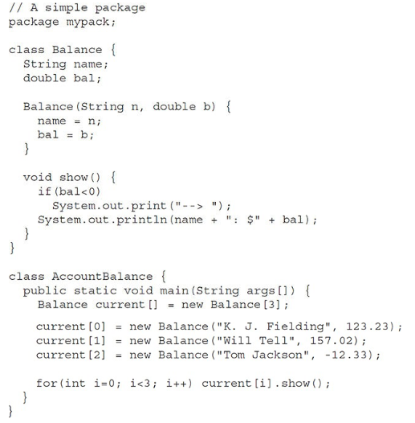
This is a package example program
Compilation:
javac AccountBalance.java
The above creates a AccountBalance.class file, you put this file in a directory called mypack.
or you can also comile by using the below line:
Javac –d . AccountBalance.java
To Run:
java mypack.AccountBalance

Slide 16
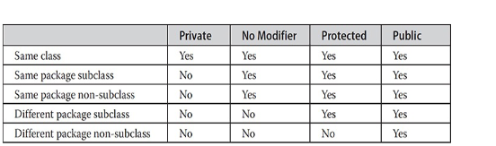
Visibility of Class members access

Slide 17
Importing (or accessing) classes from package
In a Java source file, import statements occur immediately following the package statement (if it exists) and before any class definitions.
This is the general form of the import statement:
import pkg1 [.pkg2].(classname | *);
Here, pkg1 is the name of a top-level package, and pkg2 is the name of a subordinate package inside the outer package separated by a dot (.). There is no practical limit on the depth of a package hierarchy, except that imposed by the file system.
We specify either an explicit classname or a star (*),which indicates that the Java compiler should import the entire package.
Note1: If a class wants to use another class in the same package, the package name need not be used. Classes in the same package find each other without any special syntax.
Note2: import statement should be used when a class wants to use another class, which is defined in the different package.

